Slide 1
Social media freak
Friend Zone: Liz Martinez, Greg Douglas, Jose Medina, and June Beaver
October 6, 2021

Slide 2










The World of Connection
Are we ready to connect?
Give us thumb up if you like

Slide 3



























Birds migration into our life circle
Exploration
Analyze
Ready for the tour?
Assimilation
Give us thumb up if you like

Slide 4
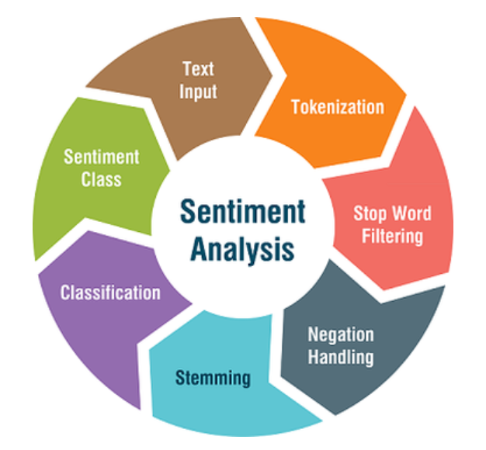

Realm of tweeps
Sentiment Classifier in Python
Naïve Bayes Classifier using NLTK (Natural Language toolkit) libraries – The tool provide the dataset that categorizes each review as positive or negative
Frequency Distribution
Extracting Concordance and Collocations
Popular NLP Sentiment analysis packages:
scikit-learn Classifiers With NLTK
VADER (Valence Aware Dictionary and sEntiment Reasoner): built-in pretrained sentiment analyzer
TextBlob: provide access to common text-processing operations through a familiar interface
SentiWordNet: an opinion lexicon derived from the WordNet database
Flair: embedding based python packages (classify vector for each synonymically similar words group)
# RiceFinTech, # FinTech
What is sentiment analysis?
Sentiment analysis is the task of determining the emotional value of a given expression in natural language.
Source: Medium, DataCamp, RealPython
Data Exploration
Notes:
Extracting Concordance and Collocations
How many times a word appears
Where each occurrence appears
What words surround each occurrence

Slide 5
Realm of tweeps
Data Exploration

Slide 6
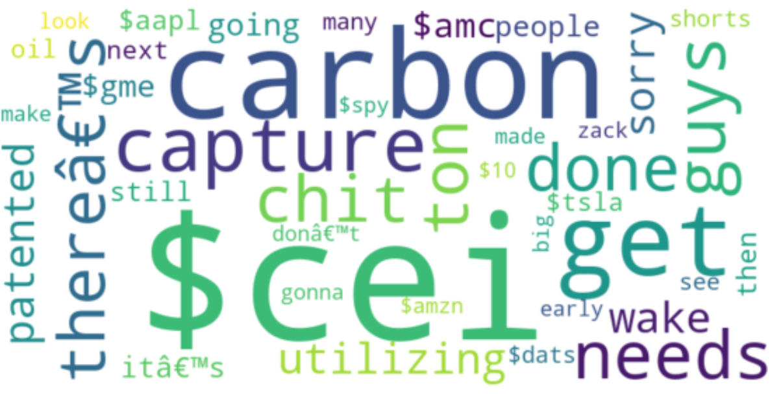
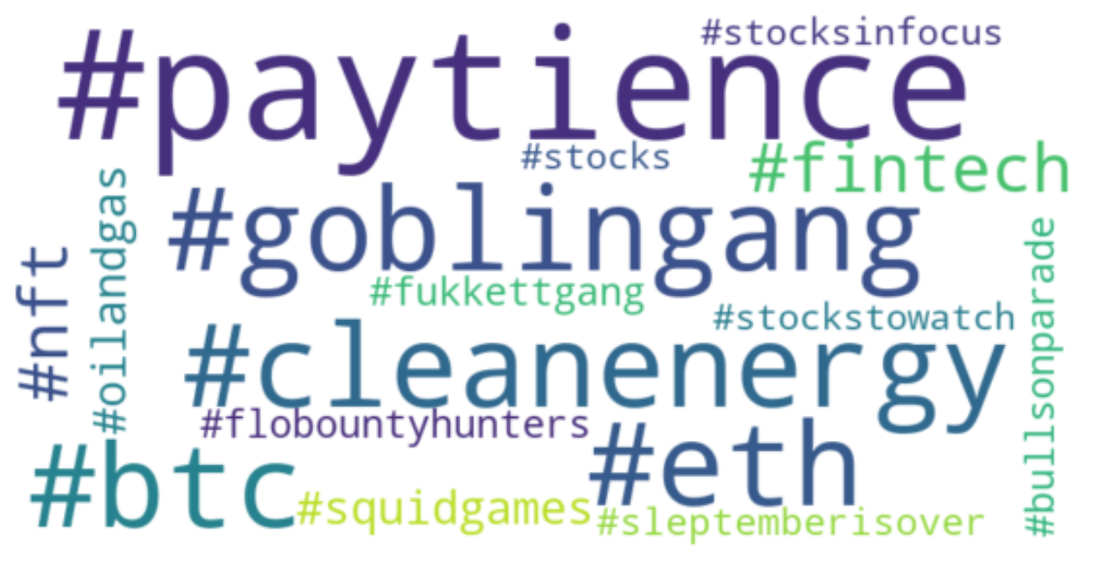
Realm of tweeps
Data Exploration

Slide 7


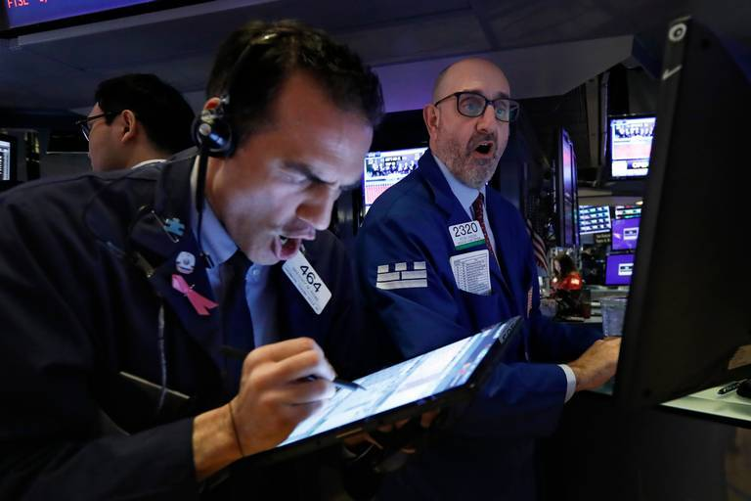




Memoji Feelings
Impact Analysis

Slide 8
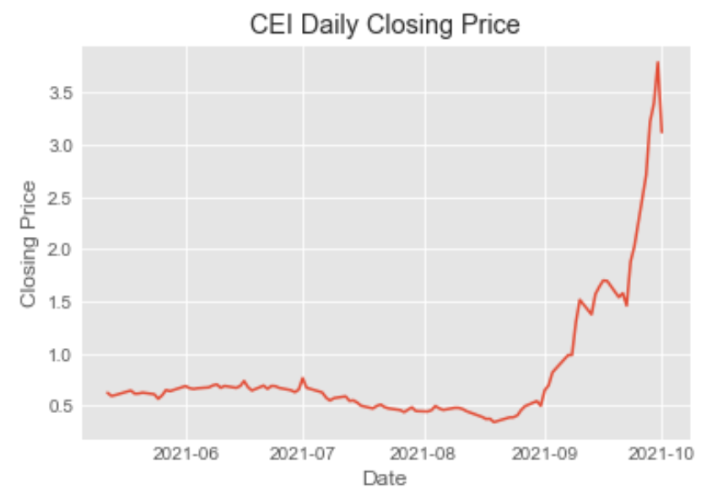
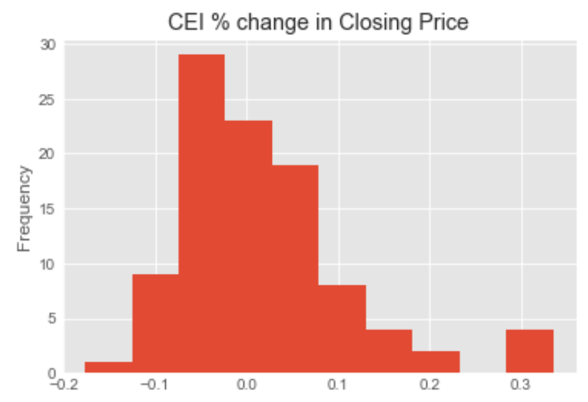
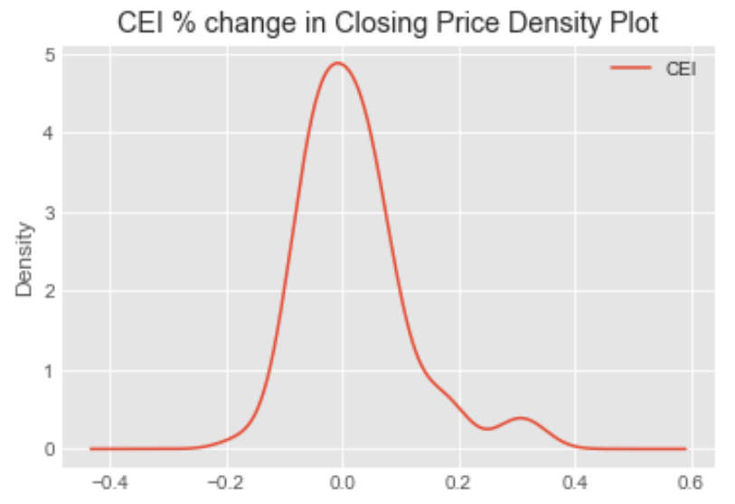
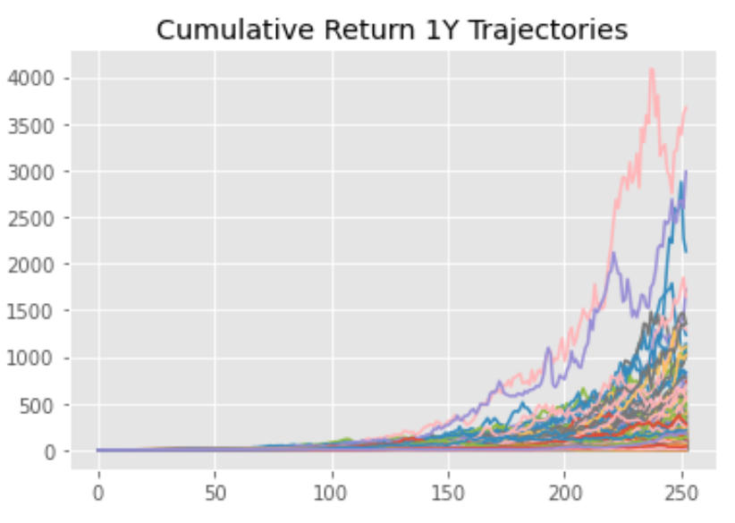
Memoji Feelings
Camber Energy Inc.
CEI (U.S.: NYSE American)
Sector
Oil Extraction
Industry
Companies on the Energy Service
1Y Sales Change
-85.52%
Yield
CEI is not currently paying a regular dividend
Profile
Camber Energy, Inc. is a Houston, Texas-based growth-oriented energy company that owns stakes in oil and natural gas assets across the US. The company also provides custom energy solutions to commercial and industrial clients across North America.
Projection: 500 Simulations
Year - 2020
The company lost 20% on just one day, 10-20-2020 with 50% gain on prior day without any justification or material information
The unusual high trading volume was from sources outside of the company, especially via the subreddit WallStreetBets (WSB)
Year - 2021
Change in vision affect prediction in 2021
Caught investor attention in early 2021 as it heavily mentioned on Reddit’s WallStreetBets forum
As of late September 2021, the short interest in CEI stock stands at 6.14 million out of the total 104.2 million shares.
Impact Analysis
Source: WSJ, Capital
Notes:
Company Visions announced in late Dec. 2020 (by James Doris, CEO)
Transform Camber Energy into a leading diversified energy company by acquisition of growth potential company(independent exploration and production)
Expanding the existing exploration and production unit with sustainable and renewable energy alternatives
Year 2021 Events
14 January 2021: Eliminated $18.9m (company worth less than $200m
14 July 2021: Camber Energy receives a $15m investment from an institutional investor;
9 August 2021: Camber Energy acquires a majority stake in Simson-Maxwell, a manufacturer and supplier of industrial engines and other products; and
25 August 2021: Camber Energy enters into an Exclusive Intellectual Property License Agreement with ESG Clean Energy for exclusive use of the ESG Clean Energy System, which generates clean electricity while capturing carbon dioxide (CO2).

Slide 9
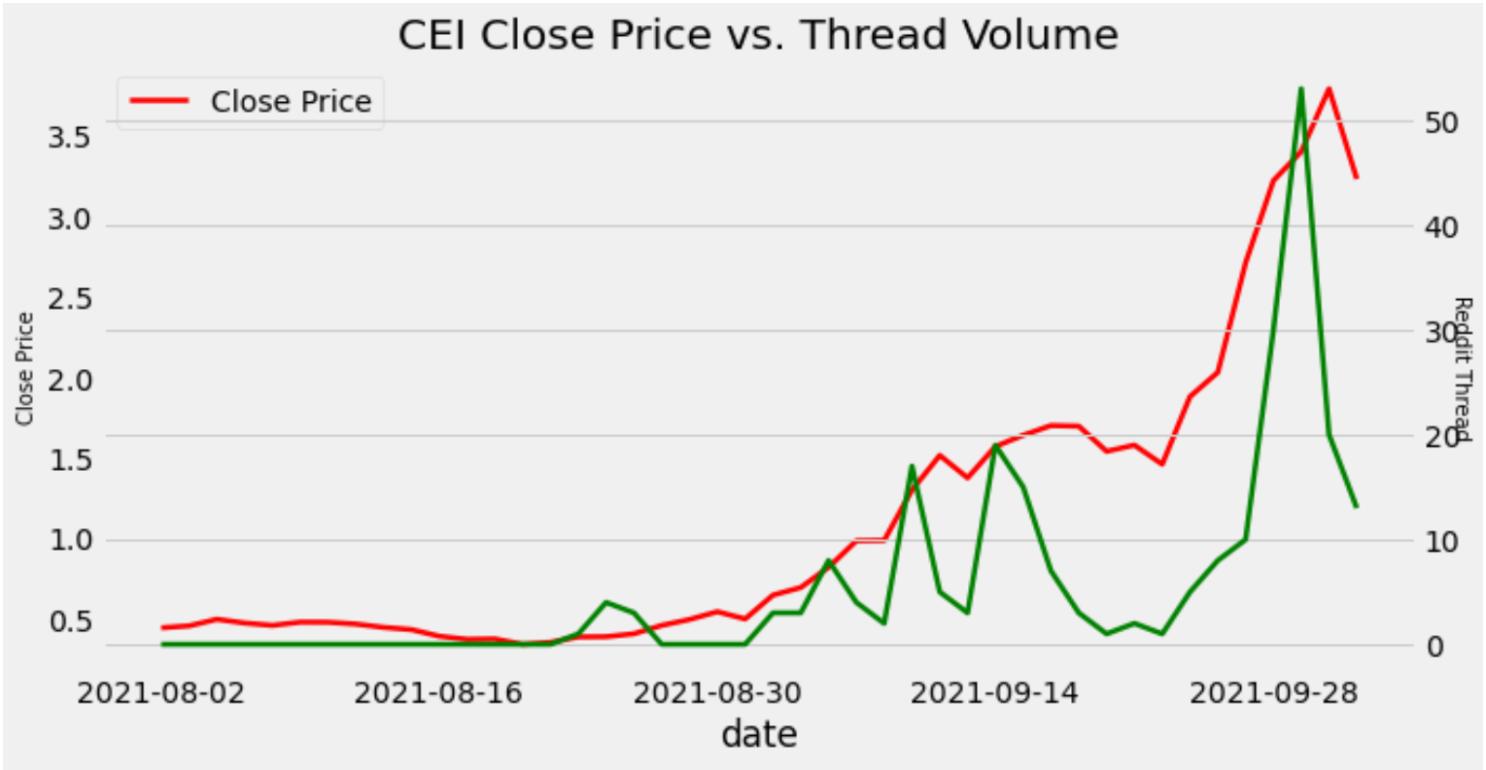
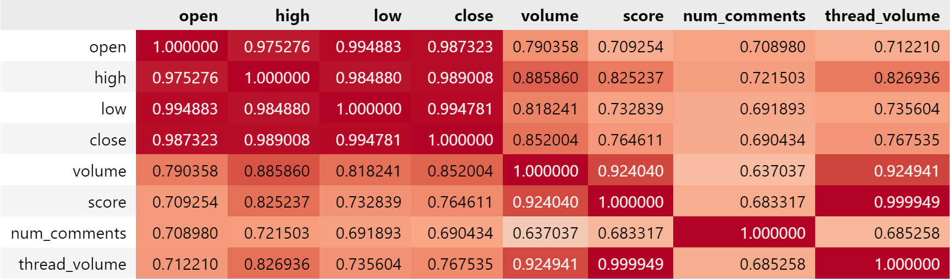
Memoji Feelings
Close Price vs Reddit Thread
Data suggested that social media thread may help drive the stock price and volume
High correlation between thread volume and trade volume – 0.92
Correlation between close price and thread volume was at 0.77
The upvoted score also high correlates to the volume surge
Give us thumb up if you like
Impact Analysis
Note: Only Reddit data was considered in this analysis

Slide 10
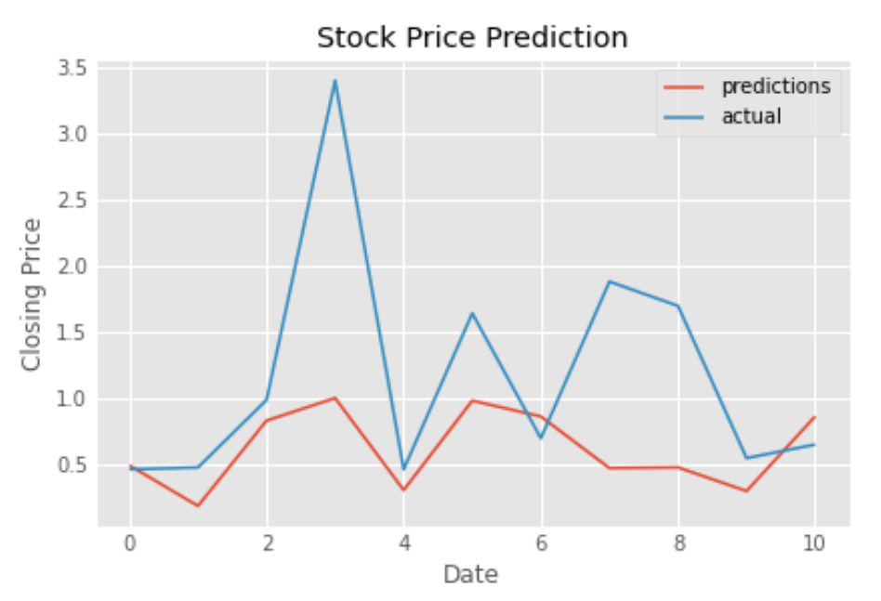
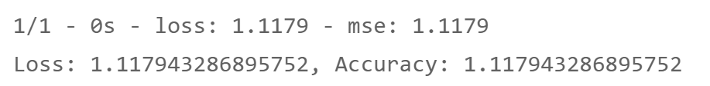
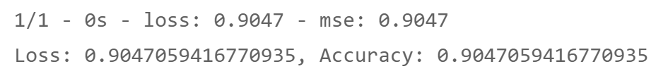
Happily Ever After (may be?)
Neural Network - TensorFlow
Input features
Thread Volume
Score
Number of Comments
Change in price (open/high/low/close)
Change in trade volume
Activation Function
Input – Relu (Rectified Linear Unit)
Output - Tanh (s - shaped)
Loss Function
mean_squared_error
Result
Underfitting-the algorithm does not fit the data well enough (high error rate in both traing and testing data)
Note: Graph shows result of Test data prediction
Training data score
Testing data score
Assimilation

Slide 11
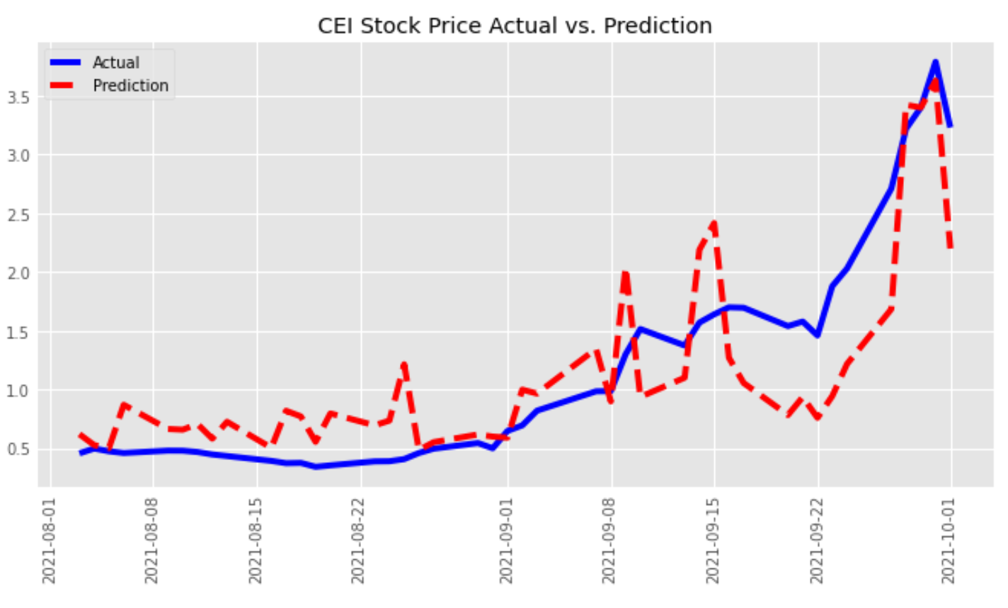
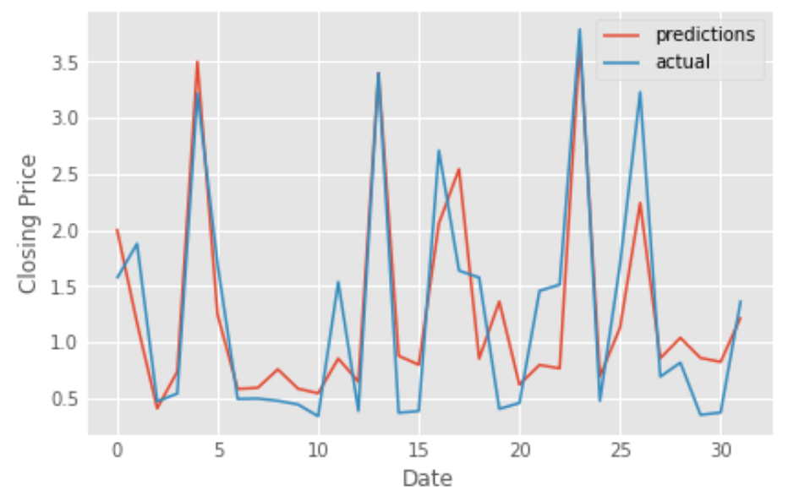
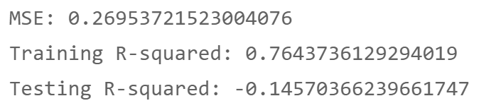
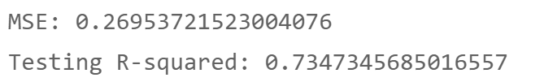
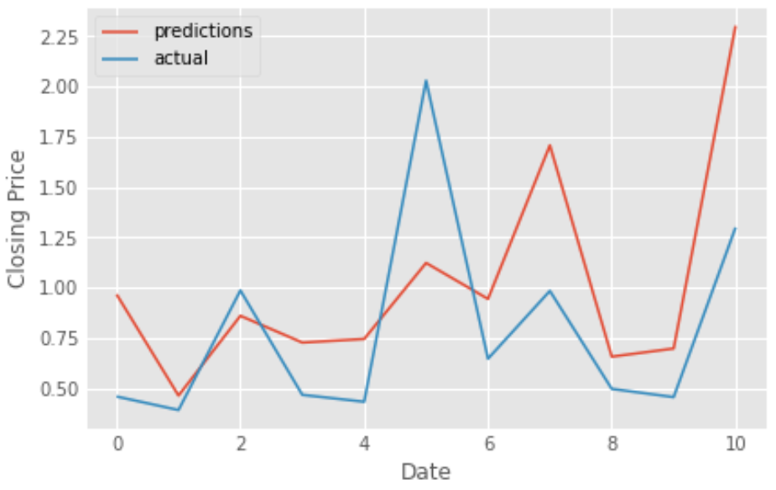
Happily Ever After (may be?)
Linear Regression
Before Train & Test Data
Testing dataset
Test size = 0.25
Testing dataset
The model is overfitting - accuracy of the training was above 75% but extremely poor in predicting the test set
Assimilation

Slide 12
Happily Ever After (may be?)
Give us thumb up if you like
Positive
Stock sentiment analysis can be used to determine investors' opinions of a specific stock or asset
Create efficient allocation of capital
Promote collaboration / research sharing for medium or small size company
Hint a future price action
Use as a marketing tool to promote company visions / plan
Cost effective / spread out messages in matter of seconds / open 24 hours
Negative
No boundary / hard to control
Speculative mania with explosive Impact
Cost increase – monitor the activity
Assimilation

Slide 13

Ask Me Anything
Give us thumb up if you like

